Slide 1
Part I
August 12th, 2020
Welcome

Slide 2
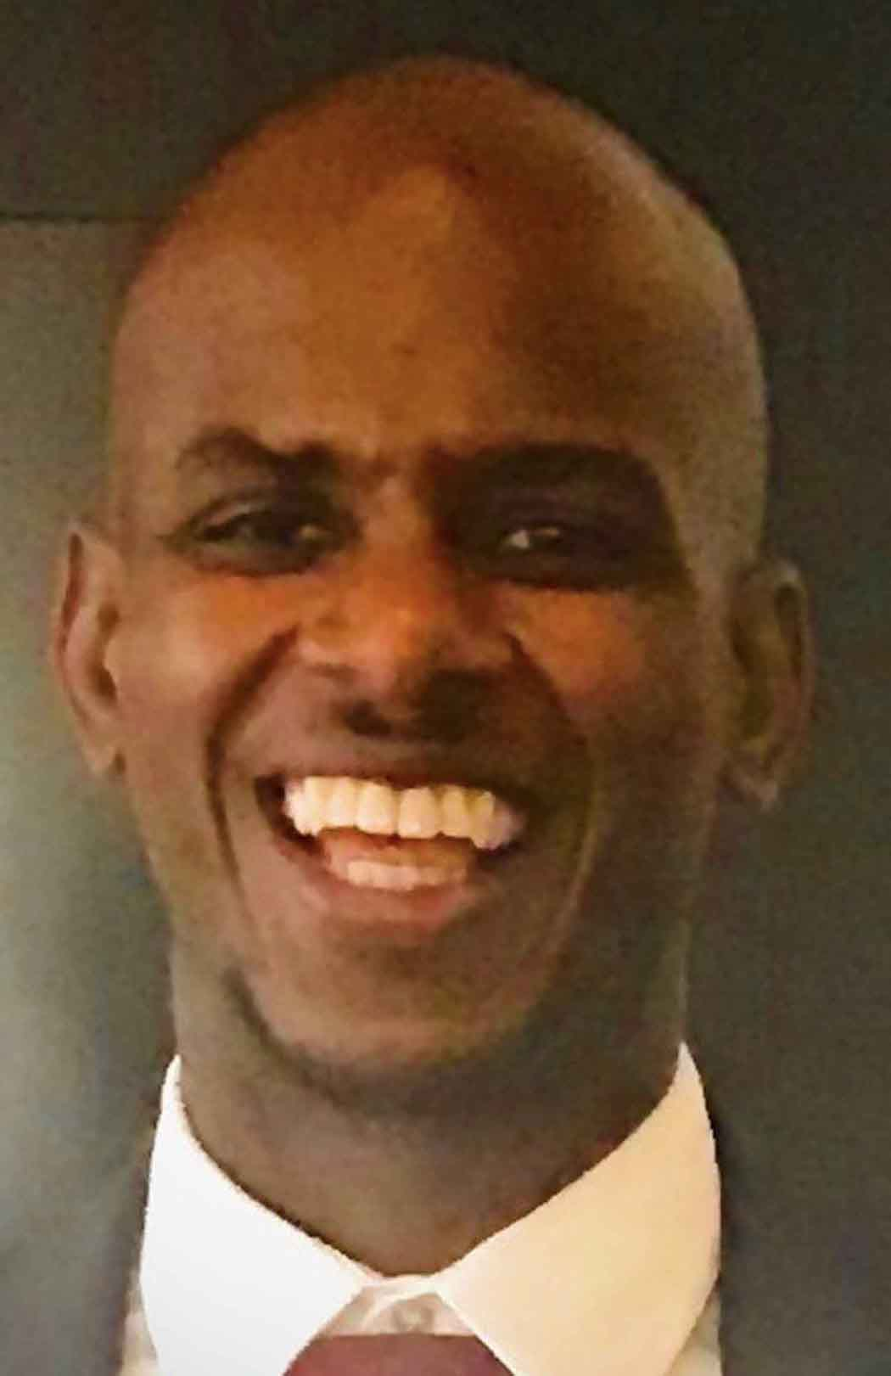
Kristopher McLucas, LCSW
Emcee

Slide 3
Program
• Marty Weiss – Personal Story
Mary Weaver – Welcome from Host
• Reaver Bingham – Why This Issue is Important
• Janice Bellucci – The Plight of Registrants
• Dr. Luis Castañón & Dr. Marco Murillo – Research Findings
• Next Steps

Slide 4
Welcome from the Host
Mary Weaver
Executive Director
Friends Outside in Los Angeles County

Slide 5
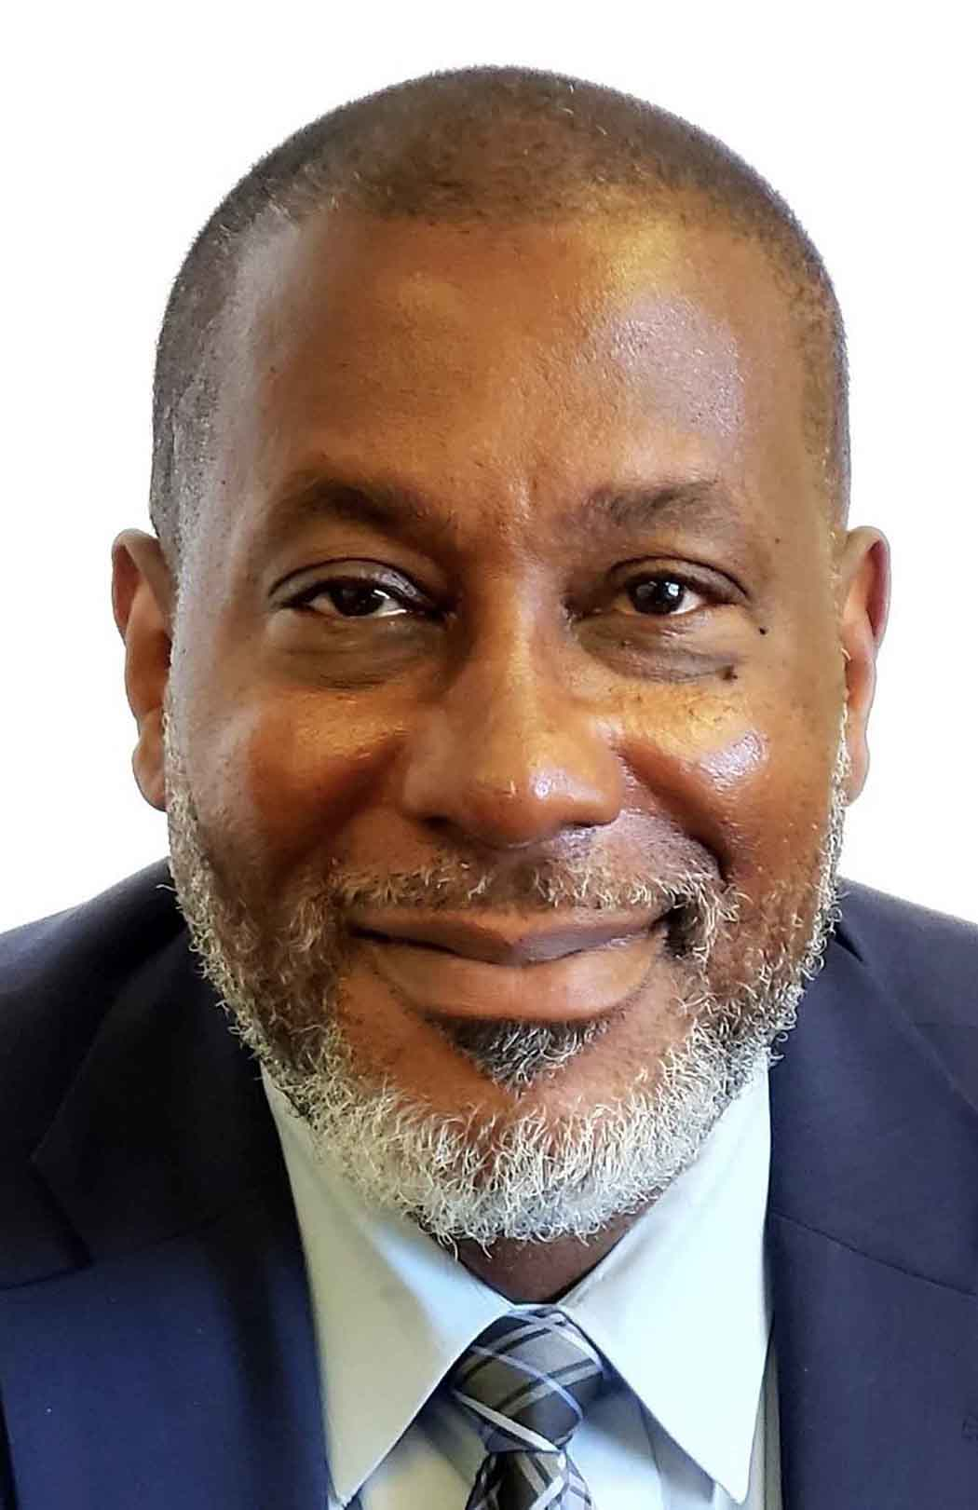
Why This Issue is Important
Reaver Bingham
Chief Deputy
Los Angeles County
Probation Department

Slide 6
Sonya Crawford
Supervising Deputy Probation Officer
Family Violence/Sexual Registrant Consultant
Sonya.Crawford@probation.lacounty.gov

Slide 7
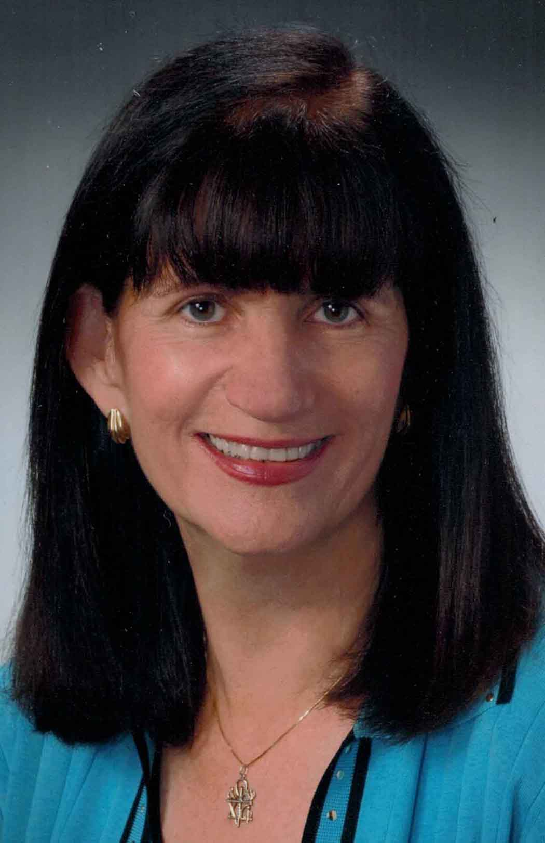
Plenary Session
The Plight of Registrants
Janice Bellucci
President
Alliance for Constitutional
Sex Offense Laws

Slide 8
Alliance for Constitutional
Sex Offense Laws
https://all4consolaws.org/

Slide 9
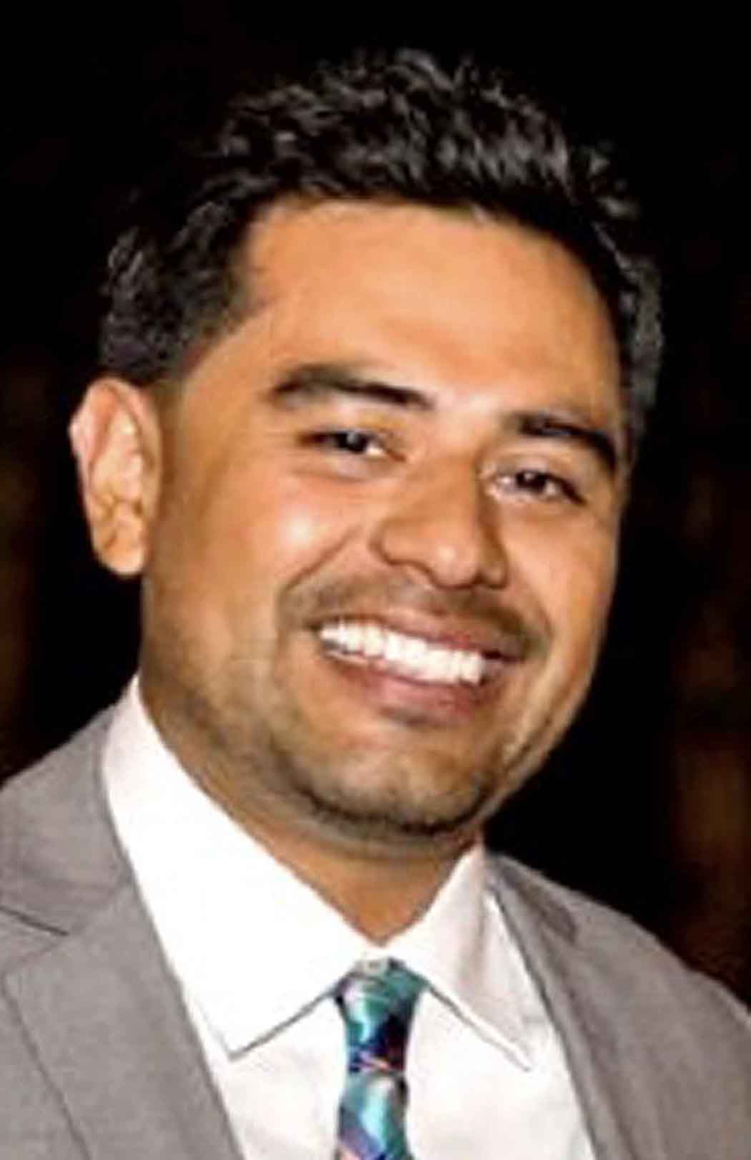
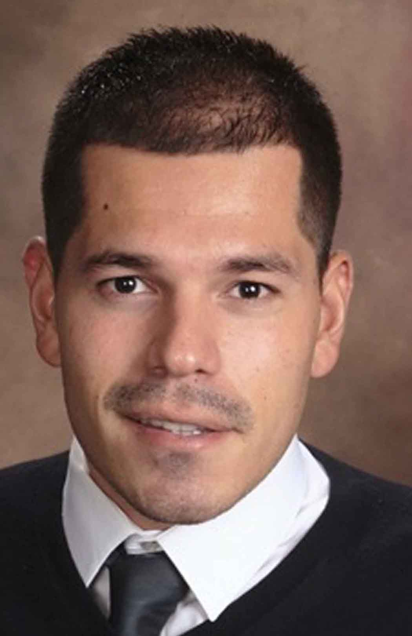
Research Findings
Dr. Luis Castañón
Researcher
Dr. Marco Murillo
Researcher

Slide 10
Next Steps
Submission of Questions
Post-Surveys: Certifications

Slide 11
Reentry Against the Odds
Summit Day Two
Wednesday Aug. 19th
10:00 – 11:30 AM
Thank you for joining us for today’s summit
.

Slide 12
Funded by
California Workforce
Development Board

Slide 13
Project Team Members and Organizations
Maria “Alex” Alexander – Center for Living and Learning Janice Bellucci – Alliance for Constitutional Sex Offense Laws Reaver Bingham – Los Angeles County Probation Department Liz Braunstein – Los Angeles County Public Defender Carroll Brown – Optimum Performance Institute Luis Barrera Castañón – LBC+ Anna Cho – Alliance for Safety and Justice Sonya Crawford – Los Angeles County Probation Department Carla Crowder – Los Angeles County Probation Department Maya DeNola – Francisco Homes Carmen Dobson – Amity Foundation Errol Fuller – California Department of Corrections and Rehabilitation Alexander Gittinger – Alliance for Constitutional Sex Offense Laws Teresa Groth – Francisco Homes Nicole Jeung – Root & Rebound Mark Judkins – Alliance for Constitutional Sex Offense Laws Ruben Ledesma – Goodwill Southern California
Simon Lopez – Goodwill Southern California Stacye Martin – California Department of Corrections and Rehabilitation Elie Miller – Loyola Law School Charly Paap – Los Angeles County Public Defender Cesar Perez – Amity Foundation Yvonne Ruiz – Alliance for Constitutional Sex Offense Laws Reba Rutledge – California Department of Corrections and Rehabilitation Nicole Sela – Francisco Homes Irena Seta – Friends Outside in Los Angeles County Arthur Smiley – Friends Outside in Los Angeles County Tranisha Tate – California Department of Corrections and Rehabilitation Joseph Taylor – Goodwill Southern California Adrineh Terantonians – Hopnest Inc Vince Thompson – California Department of Corrections and Rehabilitation Timothy Walker – A Better Living Mary Weaver – Friends Outside in Los Angeles County Andres Zuniga – Center for Living and Learning

Slide 14
Part II
August 19th, 2020
Welcome

Slide 15
Kristopher McLucas, LCSW
Emcee

Slide 16
Program
Yvonne - Personal Story
Mary Weaver–Welcome
• Curtis Notsinneh – Why This is Important
Janice Bellucci – Changes in 2021 to California’s State Registry
• Luis Castañón & Kristopher McLucas– Questions and Answers
• Maria “Alex” Alexander & Adrineh Terantonians– Project Team Experience
• Mary Weaver- Next Steps & Closing

Slide 17
Welcome from the Host
Mary Weaver
Executive Director
Friends Outside in Los Angeles County

Slide 18
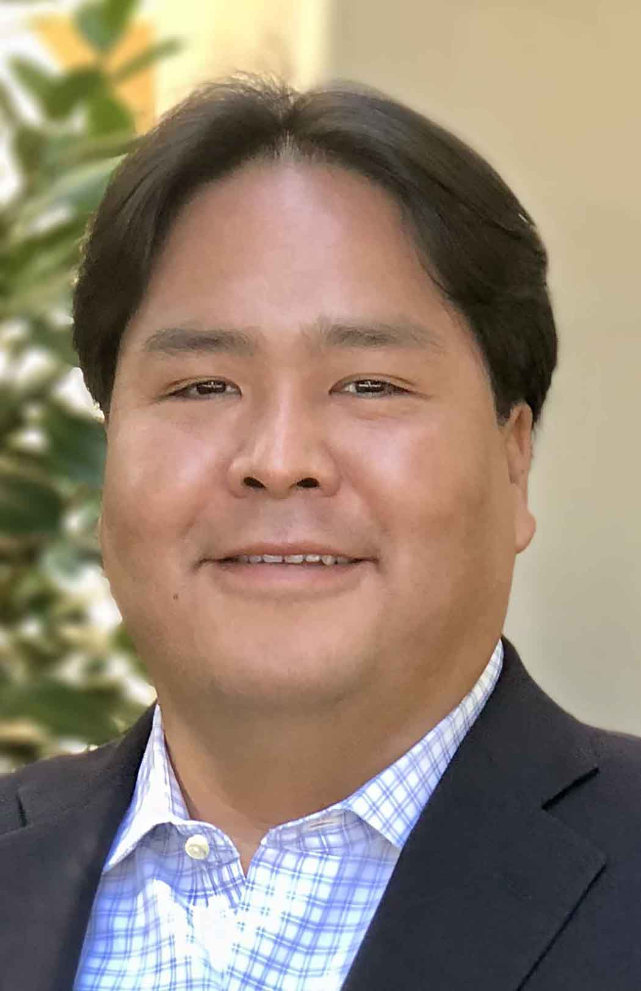
Why This Issue is Important
Curtis Notsinneh
Chief Deputy Director
California Workforce Development Fund

Slide 19
Title Slide: Project team Names (need those names
https://cwdb.ca.gov/

Slide 20
Plenary Session
Changes in 2021 to
California’s State Registry
Janice Bellucci
President
Alliance for Constitutional
Sex Offense Laws

Slide 21
Alliance for Constitutional
Sex Offense Laws
https://all4consolaws.org/

Slide 22
Dr. Luis Castañón
Researcher

Slide 23
Questions
And
Answers
Dr. Luis Castañón
Kristopher McLucas

Slide 24
Administrative Policy Question
Can you comment on the fact that as a Registrant you will be fined for going on the Megan’s law website? You aren’t even able to see what other people see?

Slide 25
Client Legal Question
Are there rules prohibiting visits of children with 290 Registrants?

Slide 26
Research Question
Have there been impacts from Ban the Box around employment access? As it relates to Registrants.

Slide 27
Resource Question
Are there resource documents describing the following: History of California Sex Offender Registry, Containment Model, and SB 384?

Slide 28
Project Team Experience
Maria “Alex” Alexander & Adrineh Terantonians

Slide 29
Next Steps
Improving Outcomes for Individuals with Sex Offenses
Workforce Development Practitioners Webinar (September)
Toolkits: Registrants and Practitioners (September)
Executive Summary (November)
Advocacy 2020:
CA Proposition 20
Title Slide: Project team Names (need those names

Slide 30
Resources:
Alliance For Constitutional Sex Offense Laws
https://all4consolaws.org/
PolicyLink
https://www.policylink.org/
Root & Rebound
https://www.rootandrebound.org/
Californians for Safety and Justice
https://safeandjust.org/
Title Slide: Project team Names (need those names

Slide 31
Resources:
Friends Outside Los Angeles County
https://www.friendsoutsidela.org/
Title Slide: Project team Names (need those names

Slide 32
Funded by
California Workforce
Development Board

Slide 33
Project Team Members and Organizations
Maria “Alex” Alexander – Center for Living and Learning Janice Bellucci – Alliance for Constitutional Sex Offense Laws Reaver Bingham – Los Angeles County Probation Department Liz Braunstein – Los Angeles County Public Defender Carroll Brown – Optimum Performance Institute Luis Barrera Castañón – LBC+ Anna Cho – Alliance for Safety and Justice Sonya Crawford – Los Angeles County Probation Department Carla Crowder – Los Angeles County Probation Department Maya DeNola – Francisco Homes Carmen Dobson – Amity Foundation Errol Fuller – California Department of Corrections and Rehabilitation Alexander Gittinger – Alliance for Constitutional Sex Offense Laws Teresa Groth – Francisco Homes Nicole Jeung –Roots & Rebound Mark Judkins – Alliance for Constitutional Sex Offense Laws Ruben Ledesma – Goodwill Southern California
Simon Lopez – Goodwill Southern California Stacye Martin – California Department of Corrections and Rehabilitation Elie Miller – Loyola Law School Charly Paap – Los Angeles County Public Defender Office Cesar Perez – Amity Foundation Yvonne Ruiz – Alliance for Constitutional Sex Offense Laws Reba Rutledge – California Department of Corrections and Rehabilitation Nicole Sela – Francisco Homes Irena Seta – Friends Outside in Los Angeles County Arthur Smiley – Friends Outside in Los Angeles County Tranisha Tate – California Department of Corrections and Rehabilitation Joseph Taylor – Goodwill Southern California Adrineh Terantonians – Hopnest Inc Vince Thompson – California Department of Corrections and Rehabilitation Timothy Walker – A Better Living Mary Weaver – Friends Outside in Los Angeles County Andres Zuniga – Center for Living and Learning

Slide 34
Webinar Produced by
Title Slide: Project team Names (need those names

